Slide 1
#ERROR 404
Hyesoo Park
Tehetena Behailu
Yasamin Salami

Slide 2
User Story
As a user, I want to share images that I think are important or worth sharing with other young people with the same age and interest.
As a first visitor, I want to see the pictures/images so that I can exchange information about the classes.
As a user, I want to share my hobbies / my favorites so that we can get to know each other more.
As a user, I want to give a grade(rate) so that I can I can express my opinion and I can show my interest.
As a user, I want to create a tag for the images so that my classmate can go through images easily.
As a visitor/ user, I would like to save images in a gallery(album) so that I can see them and share pictures later.
As a user, I want to comment on pictures so that I can give them feedbacks and detail information.
As a user, I would like to see the images organized and categorized into different categories depending on the nature of images so that I can find images easily.
As a user, I want to delete the files from my gallery(album) so that I can keep some images only which I need.

Slide 3
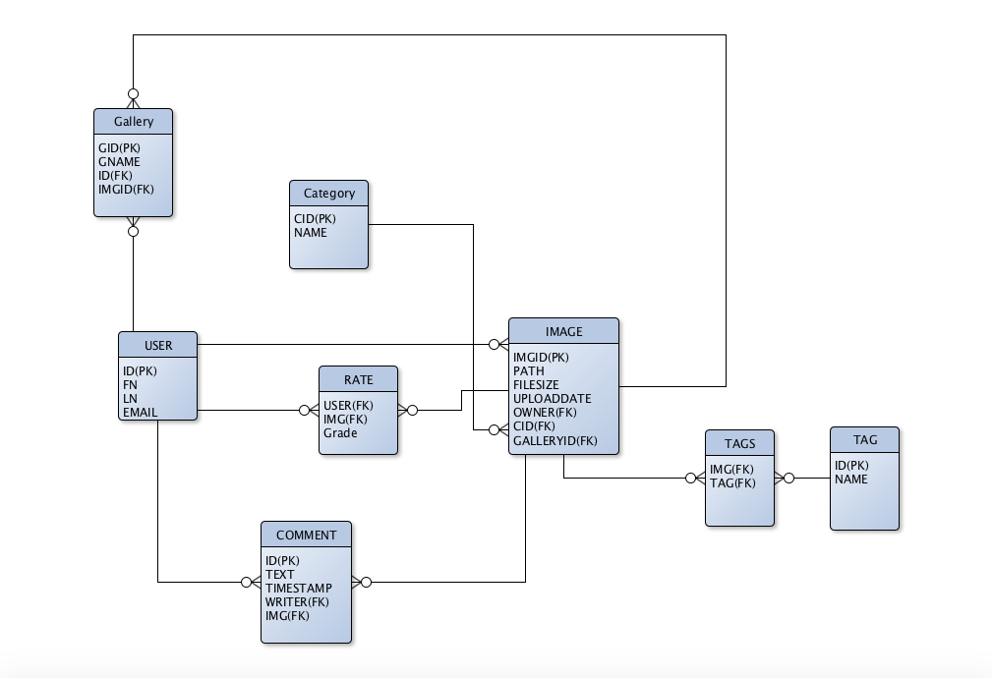
ER
Model

Slide 4
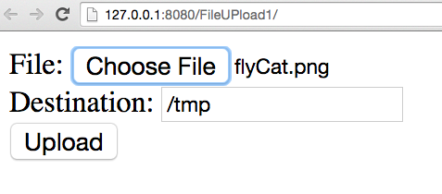
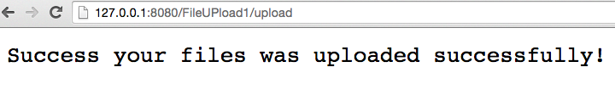

File Upload
Enctype attribute : multipart/form-data
Method : POST
The servlet(version="3.1") :
using standard API provided HttpServletRequest#getPart() to collect the individual multipart form data items

Slide 5
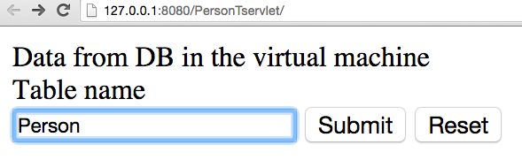
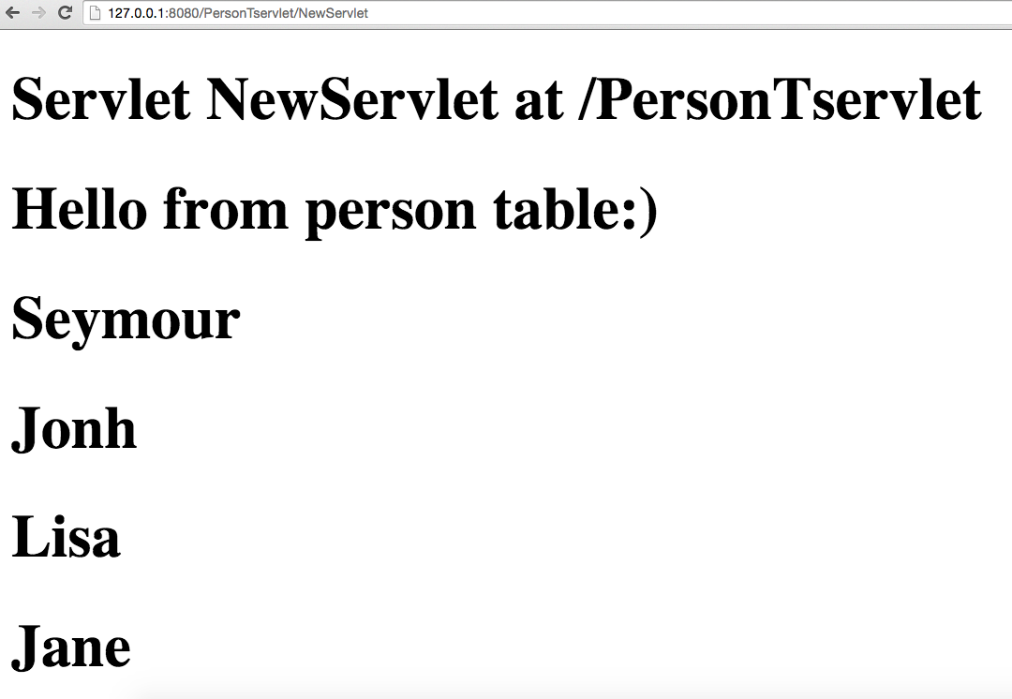
Connect MariaDB to Netbean
emf = Persistence.createEntityManagerFactory("WebApplication2PU");
em = emf.createEntityManager();
List<Person> person = em.createNamedQuery("Person.findAll").getResultList();
for (Person p : person) {
out.println("<h1>" + p.getFname() + "</h1>");

Slide 6

Persona
Lara’s story
Lara is a great passionate photographer and blogger who likes to hangout with her friends. She is studying IT and one of the her future plan is going as an exchange to another country. She likes to make new friends from all over the world to share her photos,blogs and also decide which school offers the best opportunities.
Key Goal
has different categories(sport, nature, fashion,…)
has Tinder-like dashbord for each category
Swipe pictures from different users from the category according to their interests.
Get a match and talk more
AGE: 21
OCCUPATION : Student
LOCATION: Vanha maantie 6
STATUS: Single

Slide 7

Thank you

